Slide 1
Laplacian in Graph Embedding
Yikuan Xia, Yuzhe Qin, Chutong Yang
Feb 14, 2019

Slide 2
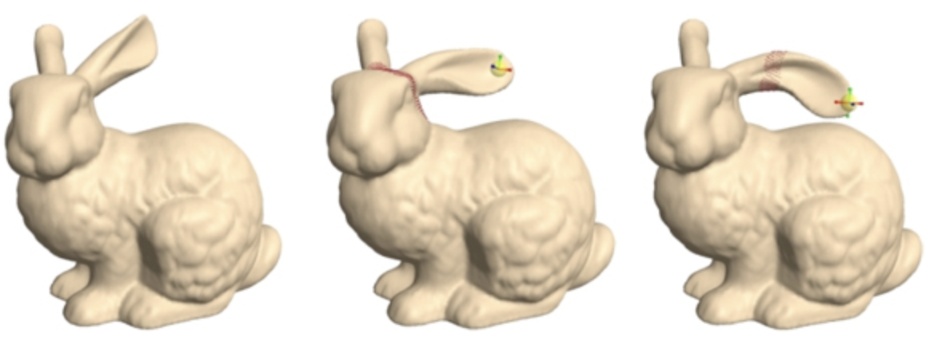
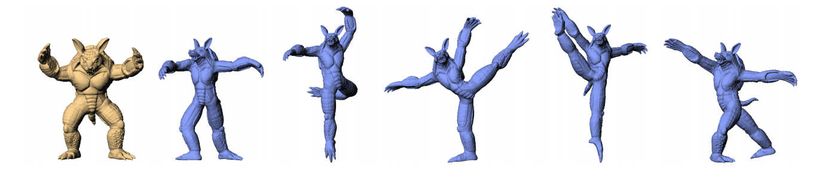
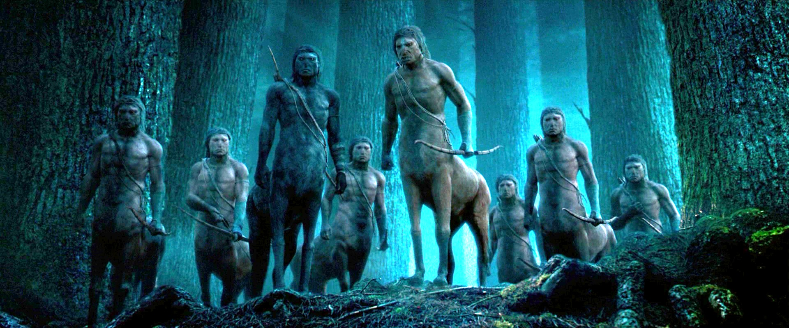
Surface Editing
Challenge:
How to preserve details of the surface as much as possible?

Slide 3
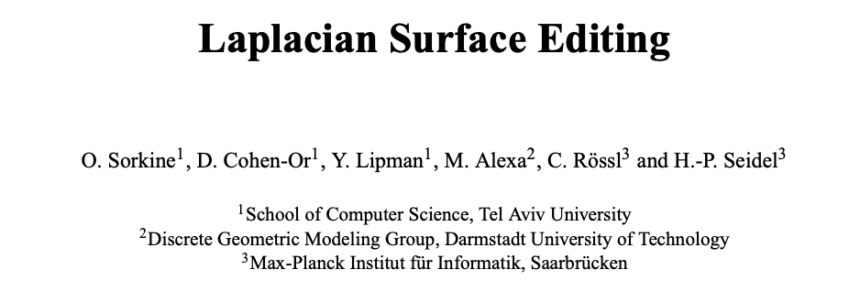

Slide 4
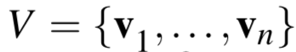
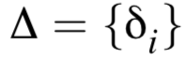
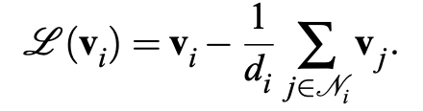
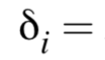
Why Laplacian?
Euclidean Coordinates
Laplacian Coordinates
indices of neighbors of v_{i}
Encode Intrinsic Geometry (local shape details) of the Surface! (How?)

Slide 5
Whiteboard Time

Slide 6
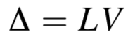
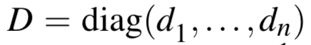
L = I - D⁻¹A
Matrix Form:
A is the mesh adjacency matrix
where d_{i} is the degree of v_{i}
Theorem: Let G be a graph. Then the dimension of the nullspace of L(G) is the number of connected components of G.
In a connected mesh, L has rank n-1. Given Δ and L, V can be recovered by fixing one vertex. (Invariant to translation)

Slide 7
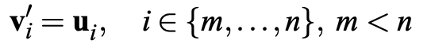
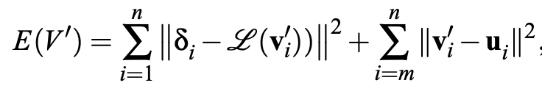
Objective
Given the original vertices V = {v₁, …, v_{n}},
Find a set of new vertices V' = {v'₁, …, v'_{n}} such that the desired constraints given by the user’s operation is satisfied, and the detail of the mesh is preserved as much as possible.
Minimize the error function:
To preserve surface details
To satisfy constraints specified by the user

Slide 8
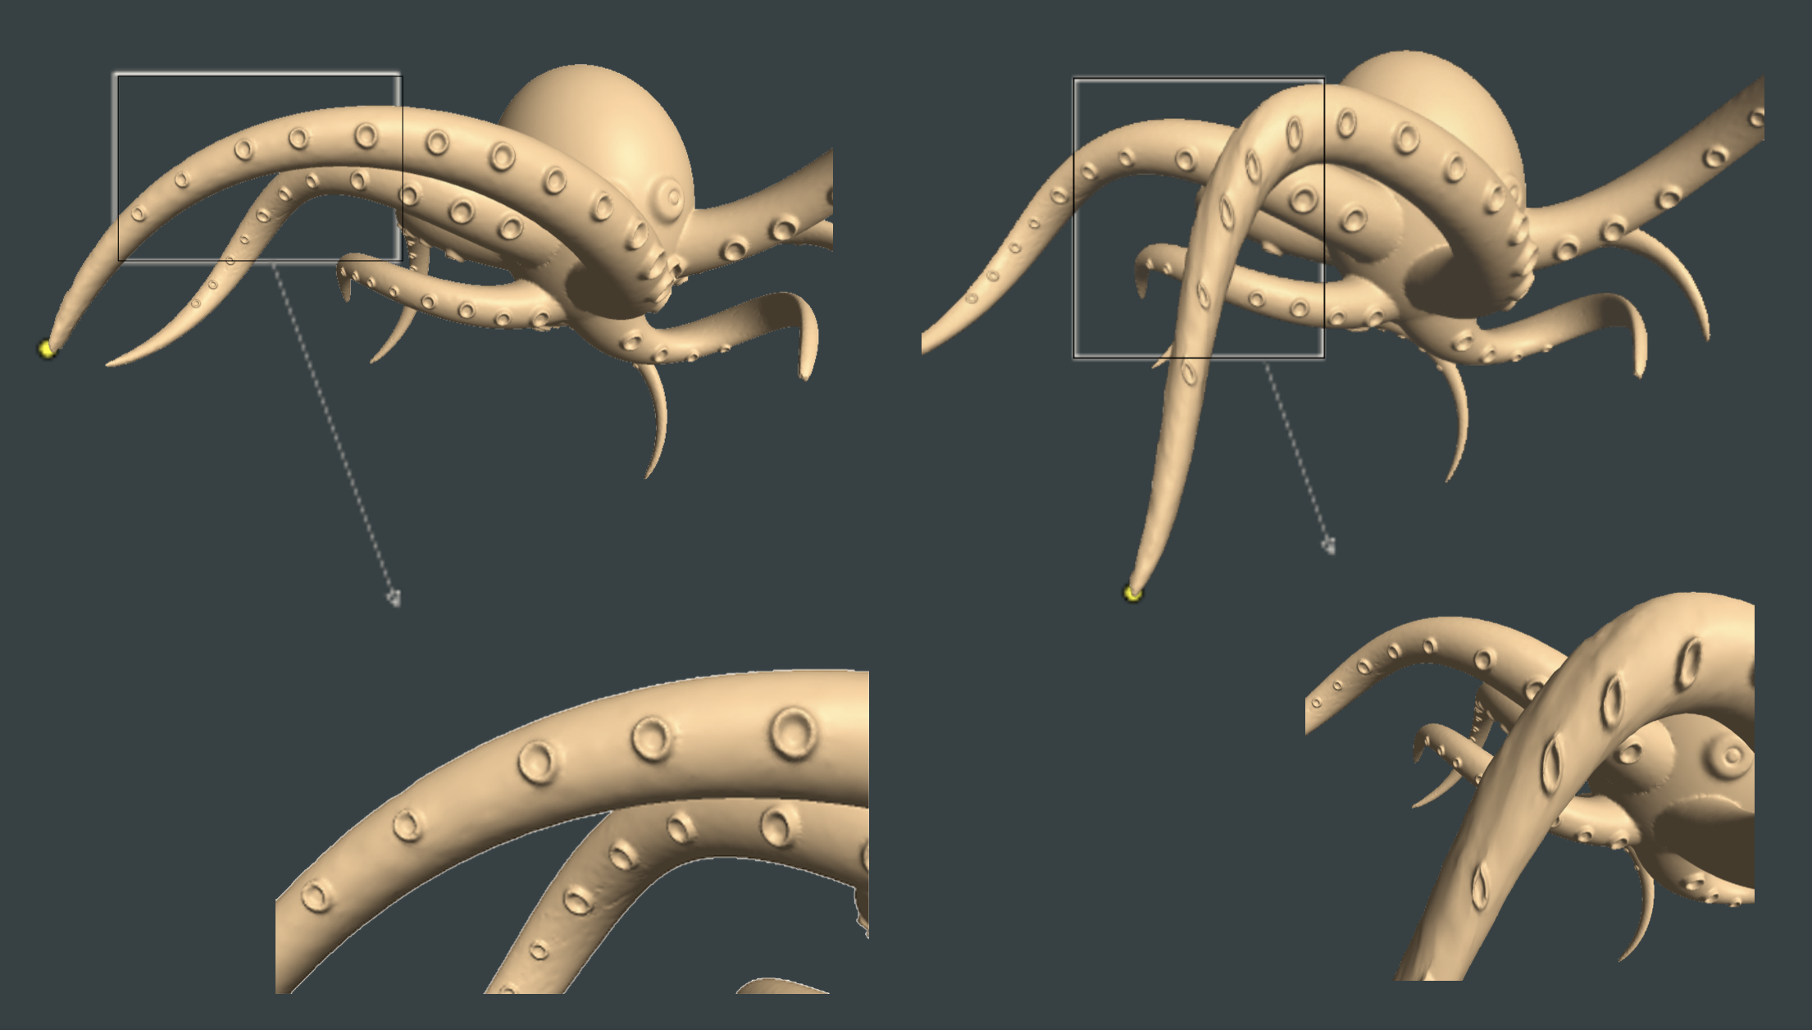
Objective
Laplacian Coordinates are only invariant to translation, not scale or rotation.
If u_{i} implies a linear transformation consisting of rotation or scaling, then details of the surface cannot be transformed properly.

Slide 9
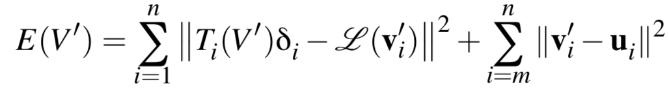
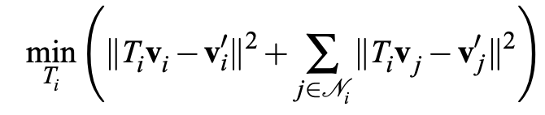
Objective
To make the laplacian coordinates robust to such linear transformations,
compute an appropriate transformation T_{i} for each vertex and revise the error function:
T_{i} is unknown but can be expressed as a linear function of V' :
T_{i} computed by:
(transformations should be similar for v_{i} and its neighbors)

Slide 10
Objective
Reasonable T_{i} should consist of translation,
isotropic scales and rotation.
Problem:
T_{i} is unconstrained and may lead to the irregular distortions which are not categorized as rigid body transformation or scaling.

Slide 11
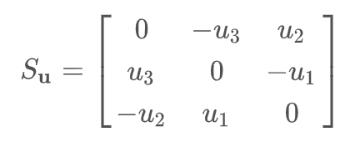
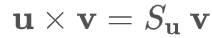
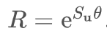
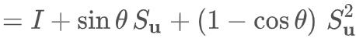
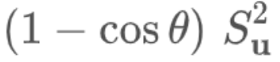
Objective
Linearize Rotation:
3D rotation determined by an axis u and a angle of rotation 𝜃
Assume u = (u₁, u₂, u₃)^{T} and ||u|| = 1
Associate a skew-symmetric matrix
For all v,
Then the rotation matrix computed by:
(Rodrigues formula)
A linear approximation is needed.
Omit when 𝜃 is small.

Slide 12
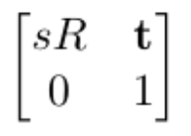
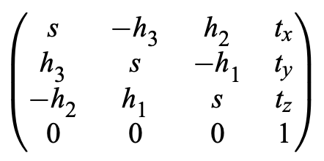
Objective:
Add in isotropic scaling s and translation t, put in homogeneous system:
Let h = (h₁, h₂, h₃)^{T} = s sin𝜃 u
T_{i} =
T_{i} is characterized by s, h and t

Slide 13
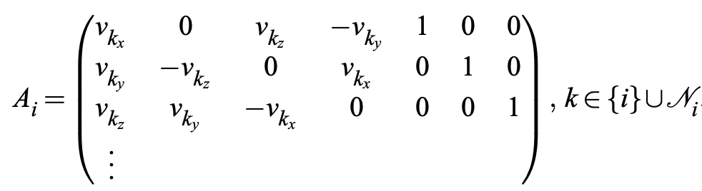
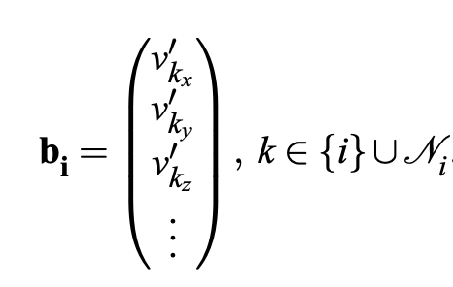
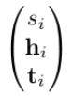
Objective:
Construct
and
T_{i} determined by minimizing || A_{i} - b_{i} ||

Slide 14
Limitation
Can’t handle rotation with large angle.

Slide 15
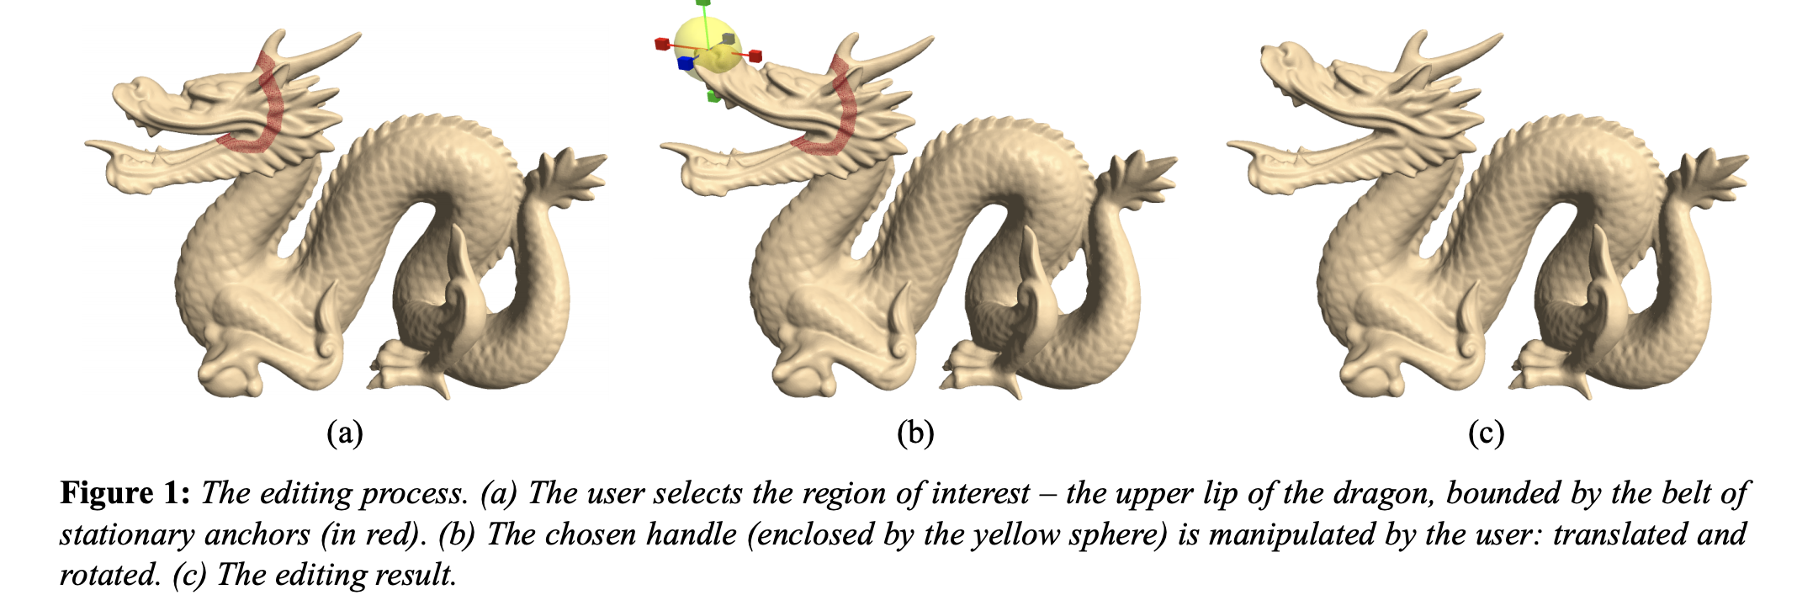
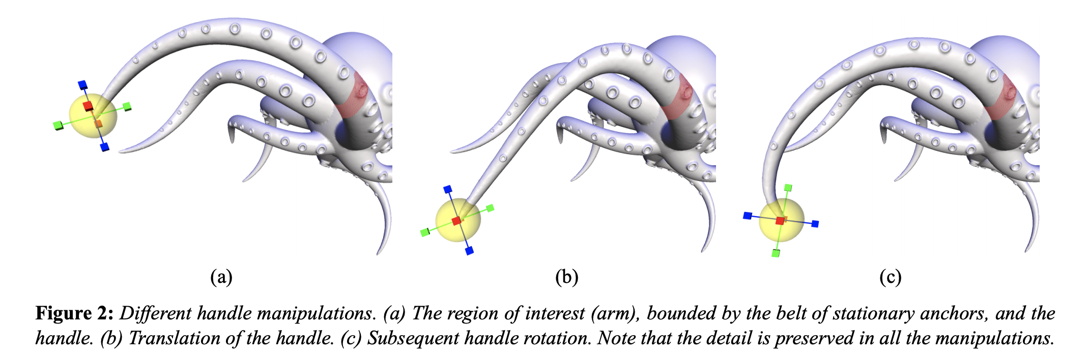
Experiment
Basic Mesh Editing

Slide 16
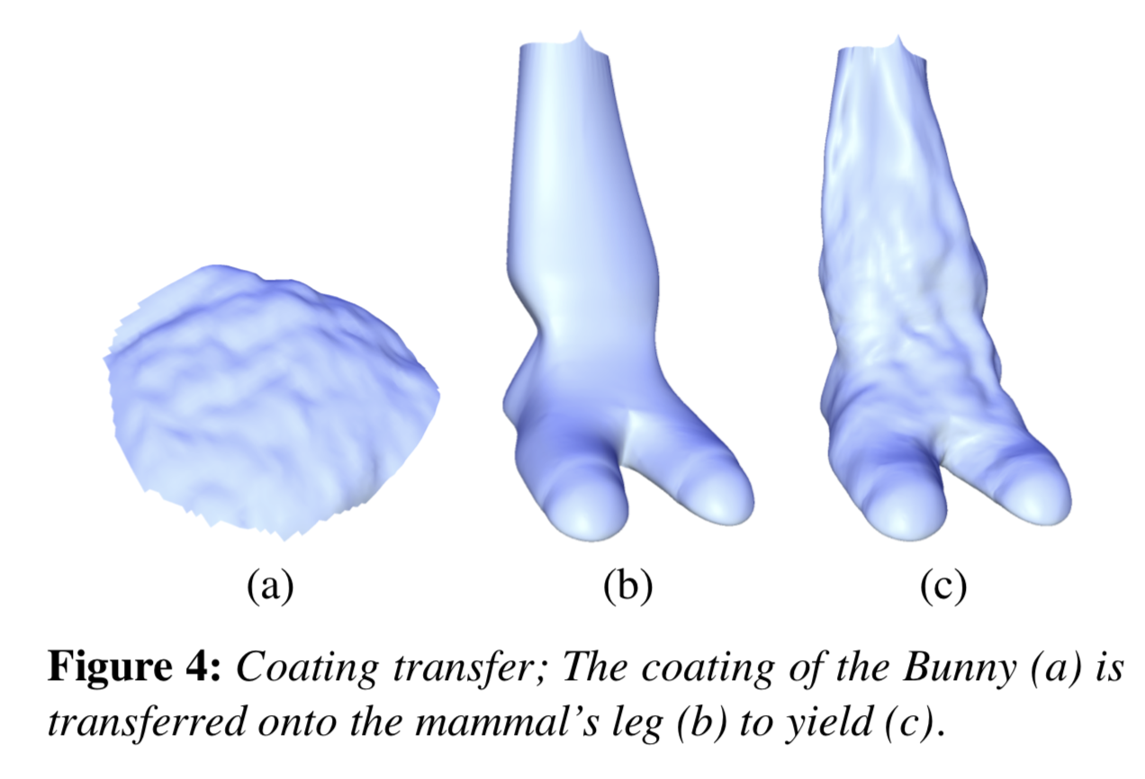
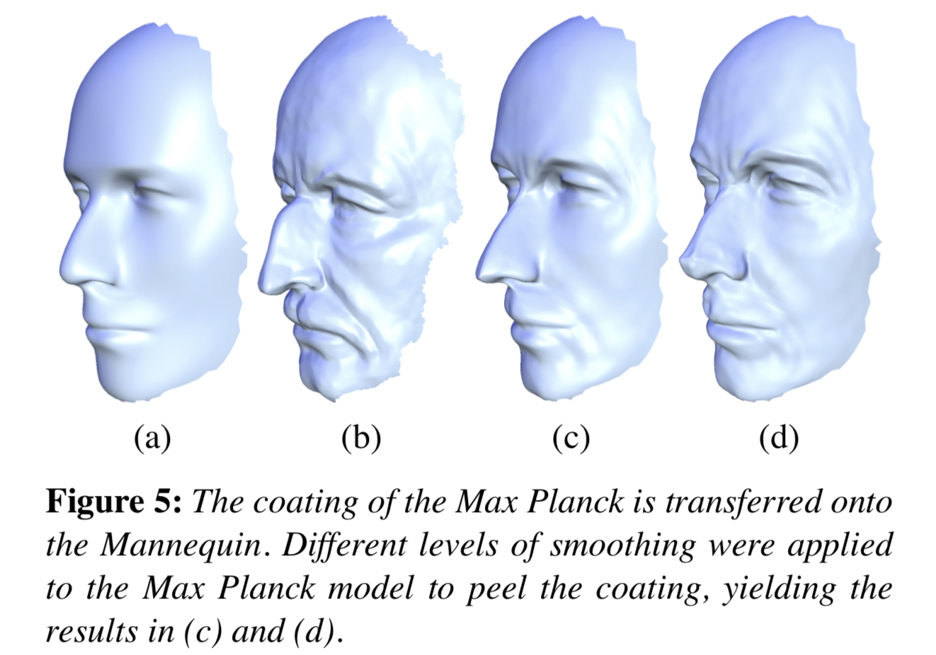
Experiment
Coating transfer:

Slide 17
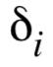
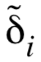
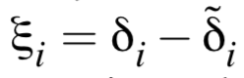
Coating transfer:
Let and be the Laplacian coordinates of the vertex i in the original surface and the same surface after smoothed (low-frequency surface). Then we can get the encoding of the coating at vertex i:

Slide 18
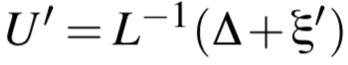
Coating transfer:
Assume that surface S and surface U share the same connectivity. Then, the coating transfer from surface S onto surface U is expressed as follows where ∆ denotes the Laplacian coordinates of the vertices of U:

Slide 19
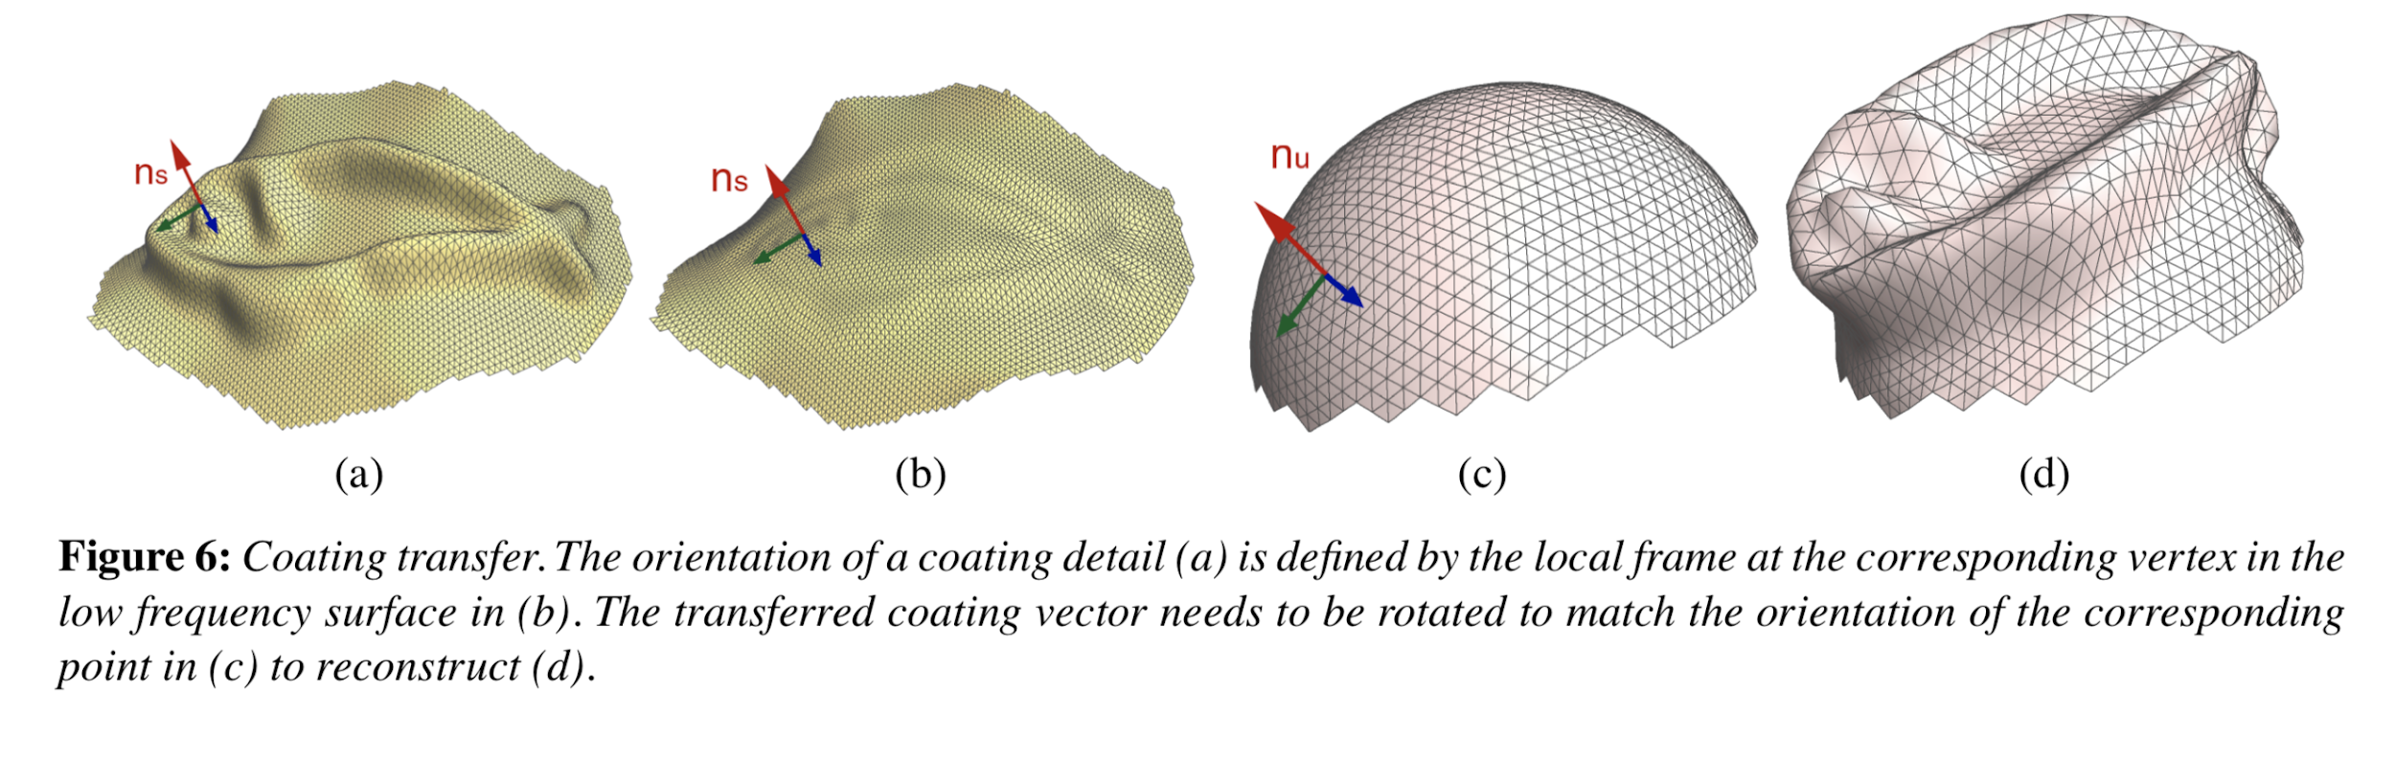
Mapping
To do the coating transfer between arbitrary surfaces with different connectivity, we need to define a mapping between the two surfaces. This mapping is established by parameterizing the meshes over a common domain.

Slide 20
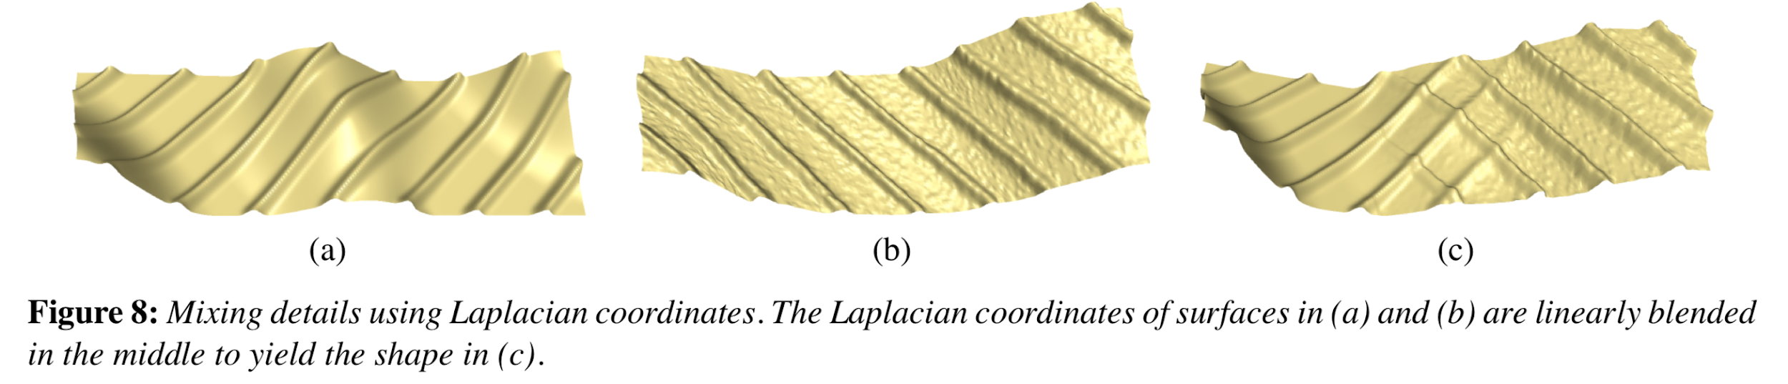
Mixed Details

Slide 21
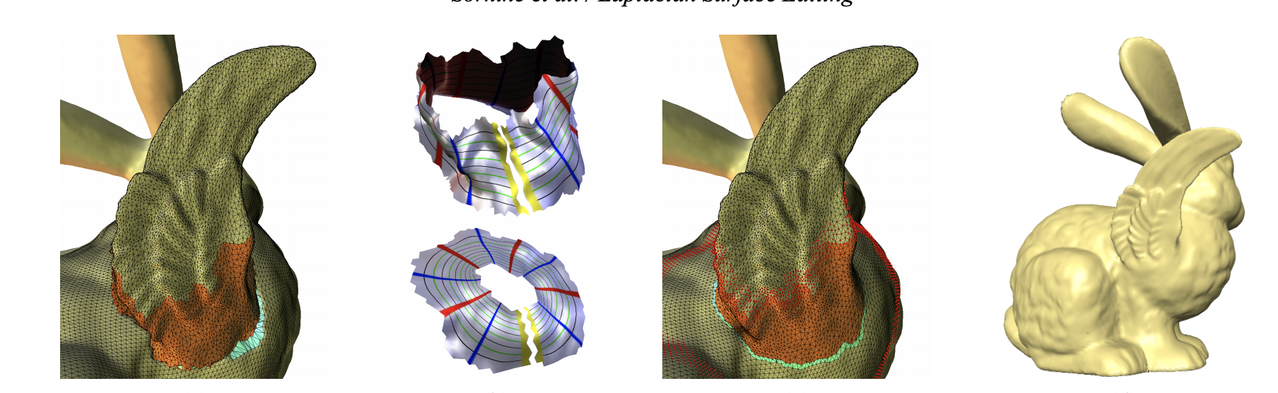
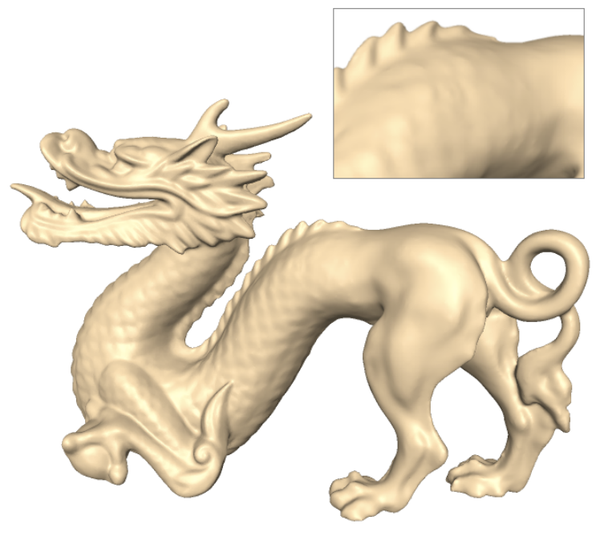
Transplanting Surface Patching
Find the transitional regions
Create the mapping
Interpolate the Laplacian coordinates

Slide 22
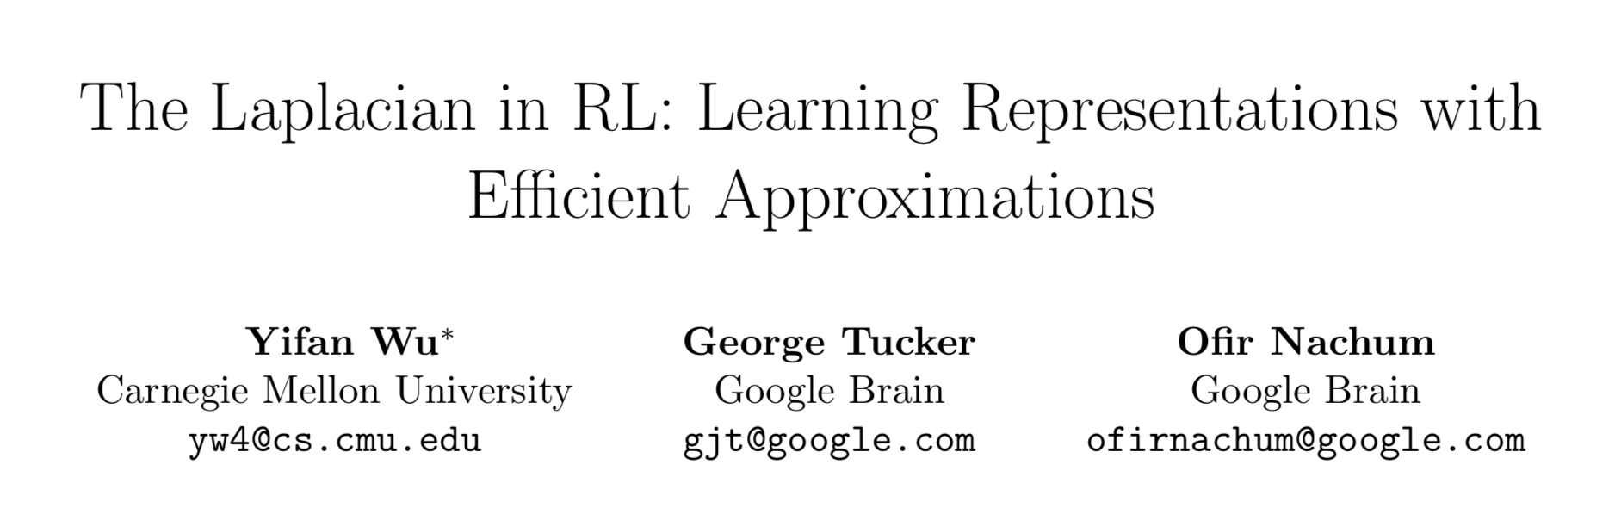

Slide 23
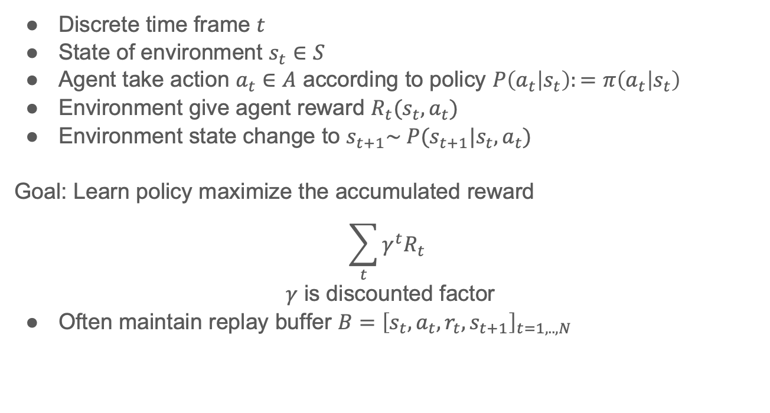
Reinforcement Learning
Discrete time frame $t$
State of environment $s_{t}∈S$
Agent take action $a_{t}∈A$ according to policy $P\left(a_{t} | s_{t}\right):=π\left(a_{t} | s_{t}\right)$
Environment give agent reward $R_{t}(s_{t}, a_{t})$
Environment state change to $s_{t+1}\sim P(s_{t+1}|s_{t},a_{t})$
Goal: Learn policy maximize the accumulated reward
$$\sum_{t}{{γ_{ }^{t}R}_{t}}$$
$γ$ is discounted factor
Often maintain replay buffer $B={\left[s_{t},a_{t},r_{t},s_{t+1}\right]}_{t=1,..,N}$
Notes:
RL is about an agent interact with a environment in a time series. For each time steps t, the state of the env is encoded as s, and the agent will take an action a based on the information of state and its policy. Then this agent will receive the reward based on the action.
Will rely on it in this work

Slide 24
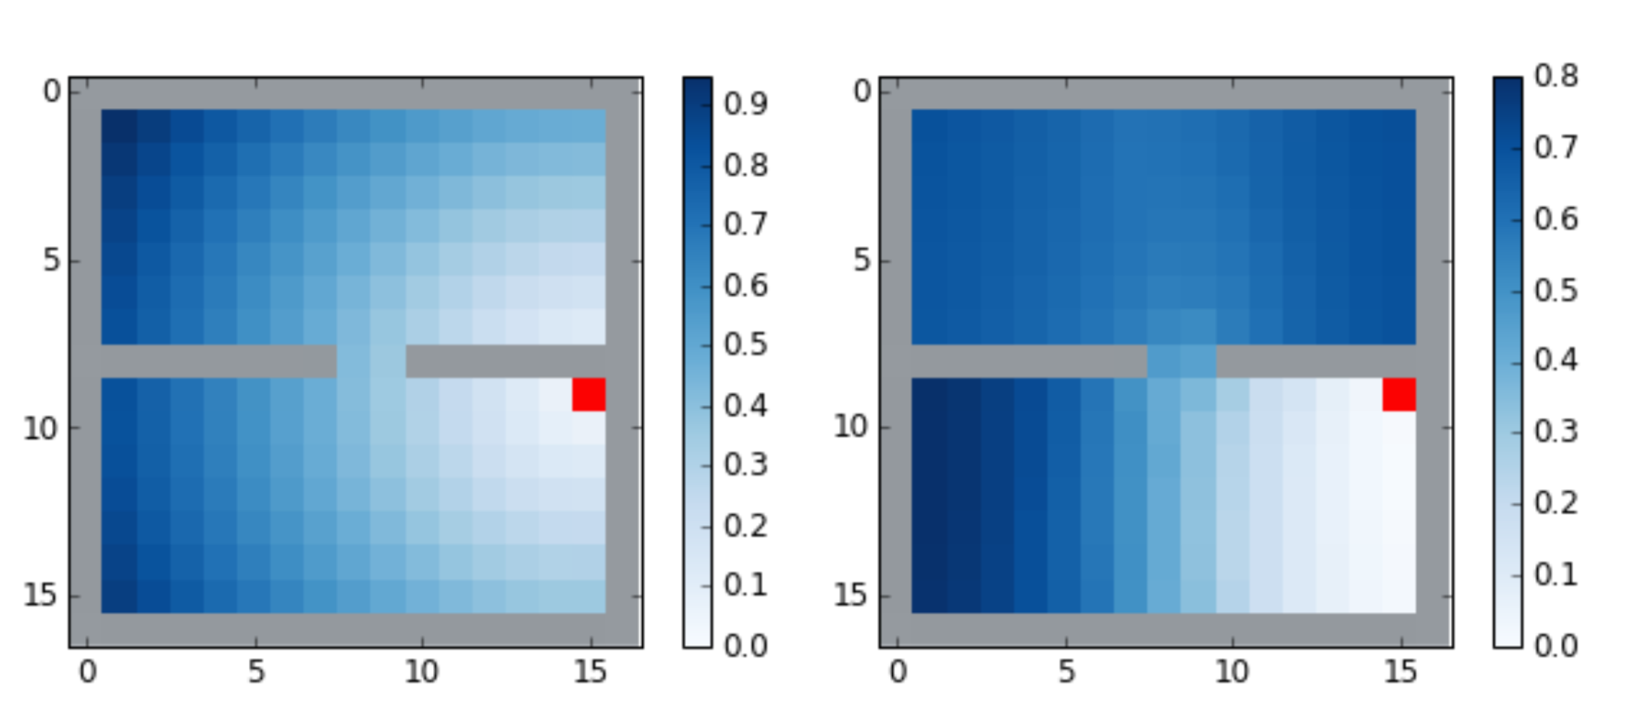
Representation in Reinforcement Learning
Performance of ML algorithm relies on the data representation
Natural question:
How to get a better task-orientation representation in RL
Answer: Laplacian induced representation is one
Reward map defined by two kind of distance to the red target
Notes:
Performance of ML algorithm relies on the data representation. If the representation can better capture the intrinsic structure towards a particular task, it will save a lot of time and effort in the algorithm section (the better the representation, the simpler the ML model). So a natural question is that: How to get a task-orientation representation in RL

Slide 25
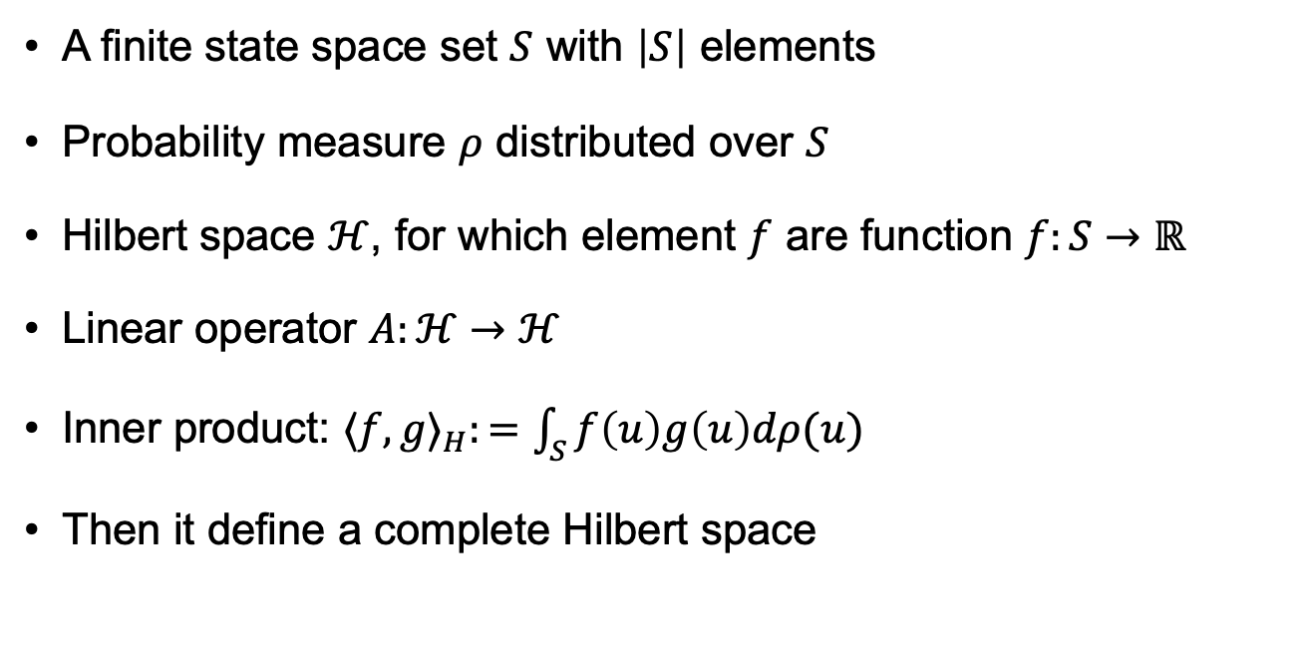
Theoretical framework
A finite state space set $S$ with $\left|S\right|$ elements
Probability measure $ρ$ distributed over $S$
Hilbert space $ℋ$, for which element $f$ are function $f:S→ℝ$
Linear operator $A:ℋ→ℋ$
Inner product: $⟨f,g⟩_{H}:=\int_{S}{f\left(u\right)g\left(u\right)dρ(u)}$
Then it define a complete Hilbert space

Slide 26
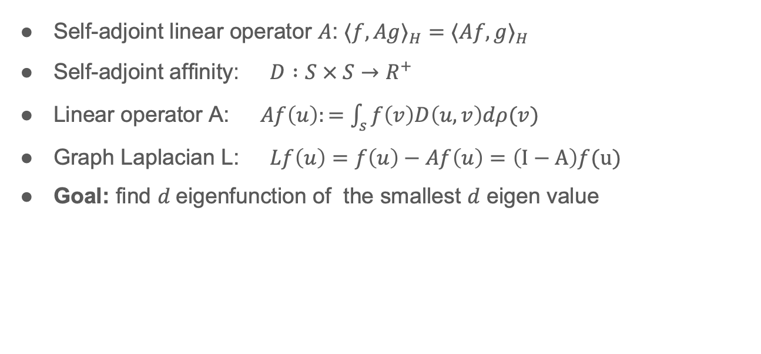
Definition of Laplacian
Self-adjoint linear operator $A$: $⟨f,Ag⟩_{H}=⟨Af,g⟩_{H}$
Self-adjoint affinity: $D :S × S→R^{+}$
Linear operator A: $Af\left(u\right):=\int_{s}{f\left(v\right)D\left(u,v\right)dρ(v)}$
Graph Laplacian L: $Lf\left(u\right)=f\left(u\right)−Af\left(u\right)=\left(I−A\right)f(u)$
Goal: find $d$eigenfunction of the smallest $d$ eigen value
Notes:
$ρ$ is a probability measure, mention the definition of $dρ(u$)
To construct graph Laplacian, consider Hilbert-Schmidt integral operators A
Then we can define the Laplacian operator on Hilbert space
Now we have this theoretical definition of the complete Hilbert space and the graph Laplacian defined on it, back to our initial goal, we want to use this framework to find the eigenfunction associated with the first smallest d eigen value

Slide 27
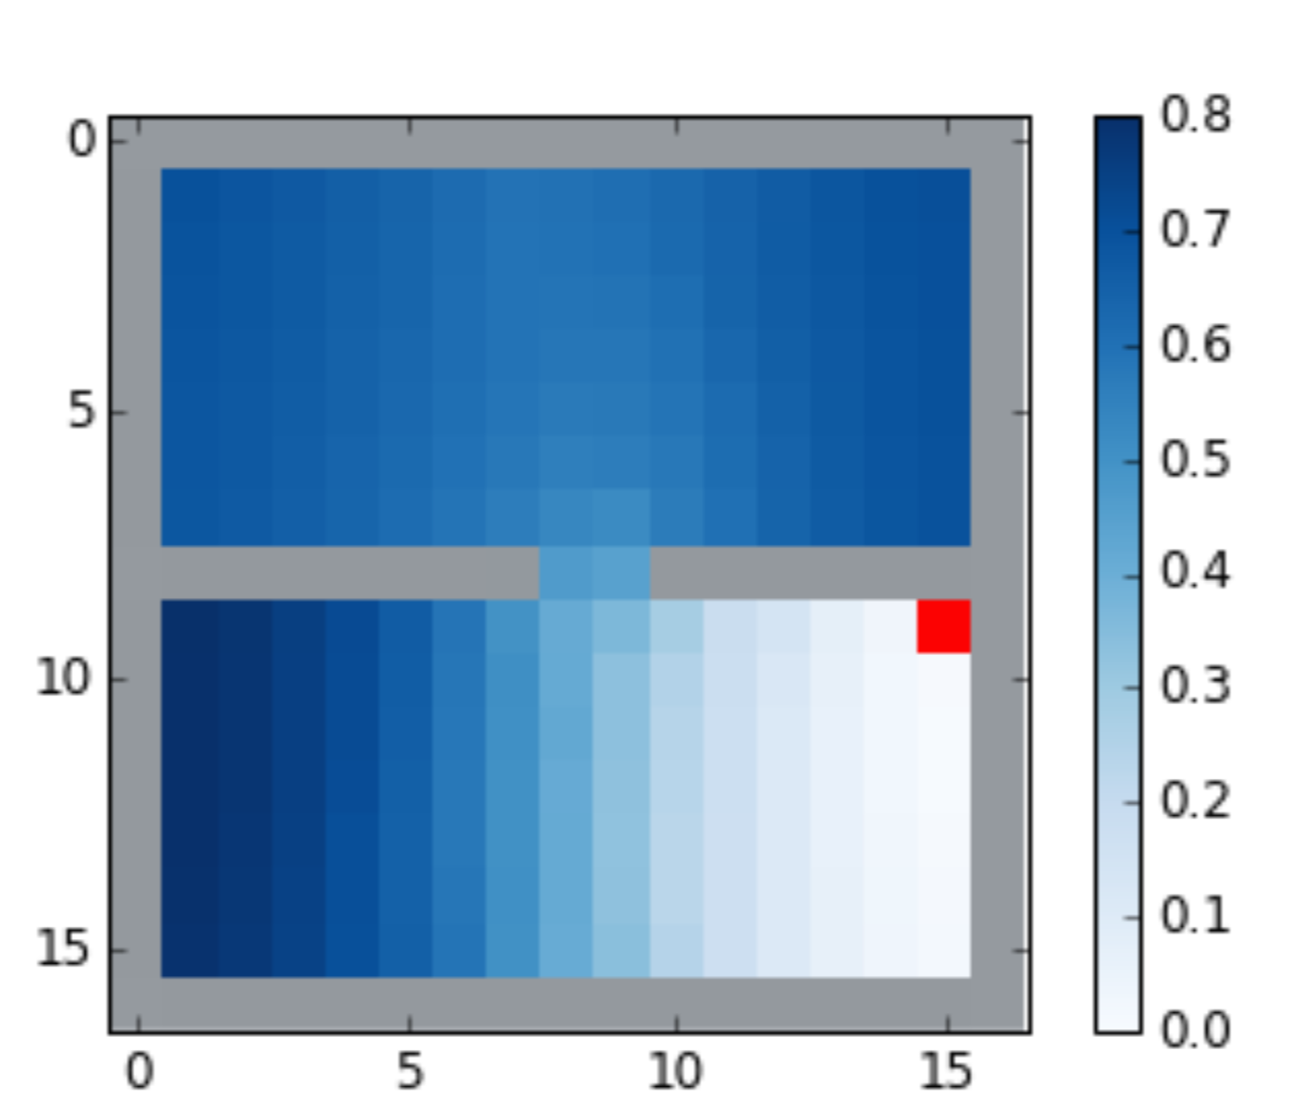
Back to Maze Problem
Reward: reach red target -> positive reward; otherwise 0
If state representation encode the real distance
Policy will simply be:
Minimize the distance to target for each step
Intuition:
Laplacian keep info of real distance
Notes:
If representation encode the real distance, which means that it include the information of the wall

Slide 28
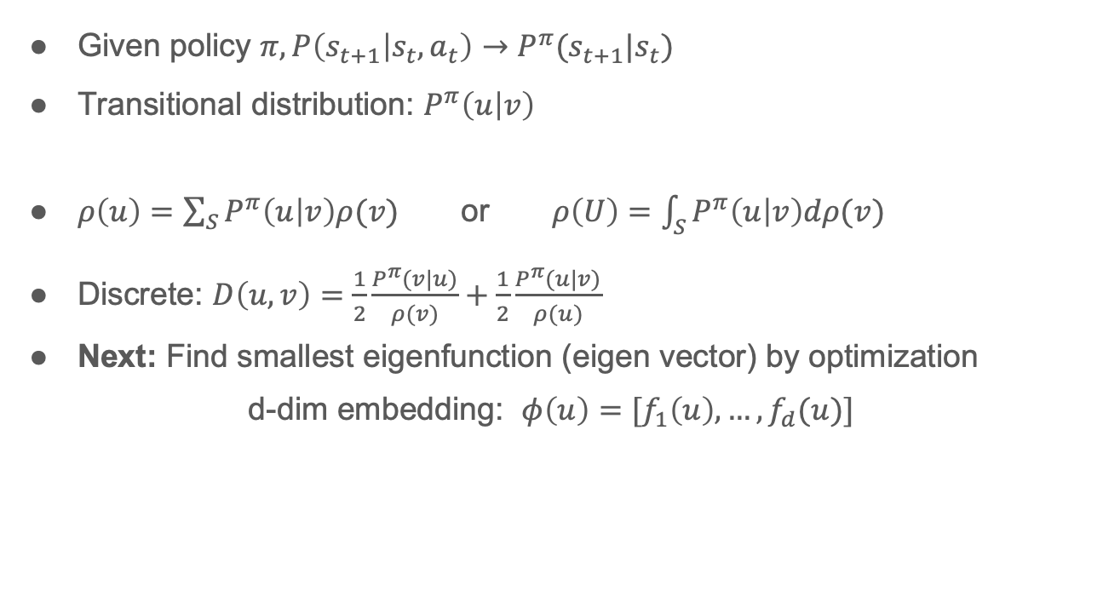
Graph Formulation in RL
Given policy $π, P\left(s_{t+1} | s_{t},a_{t}\right)→P^{π}(s_{t+1}|s_{t})$
Transitional distribution: $P^{π}\left(u | v\right)$
$ρ\left(u\right)=\sum_{S}{P^{π}\left(u | v\right)ρ(v)}$ or $ρ\left(U\right)=\int_{S}{P^{π}\left(u | v\right)dρ(v)}$
Discrete: $D\left(u, v\right)=\frac{1}{2}\frac{P_{ }^{π}(v|u)}{ρ(v)}+\frac{1}{2}\frac{P_{ }^{π}(u|v)}{ρ(u)}$
Next: Find smallest eigenfunction (eigen vector) by optimization
d-dim embedding: $φ\left(u\right)=[f_{1}\left(u\right),…,f_{d}(u)]$
Notes:
Stationary distribution rou and transition distribution P, then we can define the affinity measure in the RL setting
To avoid confusion, we only give the definition of D in discrete state space, you can substitute by a Probability density to get the continuous one. This definition is vert intuitive, right?

Slide 29
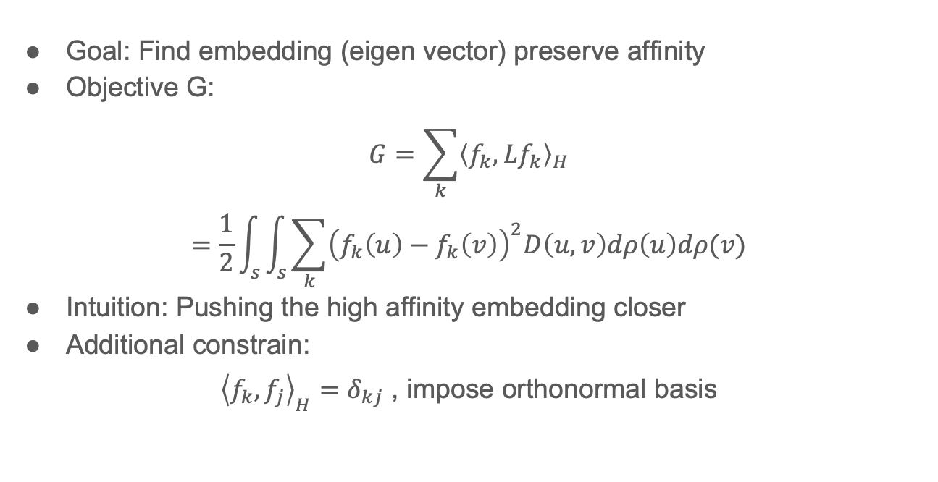
Spectral graph drawing
Goal: Find embedding (eigen vector) preserve affinity
Objective G:
$$G=\sum_{k}{{\left\langle f_{k},Lf_{k}\right\rangle }_{H}}$$
$$=\frac{1}{2}\int_{s}{\int_{s}{\sum_{k}{{\left(f_{k}\left(u\right)−f_{k}\left(v\right)\right)}^{2}D\left(u,v\right)dρ\left(u\right)dρ(v)}}}$$
Intuition: Pushing the high affinity embedding closer
Additional constrain:
${\left\langle f_{k}, f_{j}\right\rangle }_{H}=δ_{kj}$ , impose orthonormal basis
Notes:
Spectral graph drawing is an idea introduced by a previous paper, which provides an optimization perspective on finding the eigenvectors of the Laplacian.
Explain this objective, however this is not enough, since the objective may degenerate
These constrain is compatible with the goal of finding eigenfunction

Slide 30
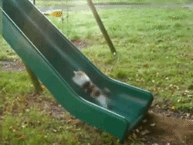

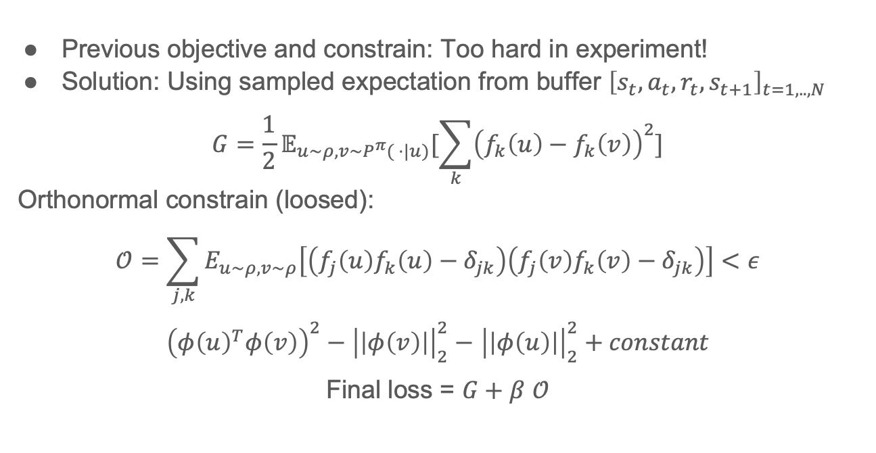
Objective to learn
Previous objective and constrain: Too hard in experiment!
Solution: Using sampled expectation from buffer ${\left[s_{t},a_{t},r_{t},s_{t+1}\right]}_{t=1,..,N}$
$$G=\frac{1}{2}𝔼_{u\sim ρ,v\sim P^{π}( ⋅|u)}[\sum_{k}{{\left(f_{k}\left(u\right)−f_{k}\left(v\right)\right)}^{2}}]$$
Orthonormal constrain (loosed):
$$𝒪=\sum_{j,k}{E_{u\sim ρ,v\sim ρ}\left[\left(f_{j}\left(u\right)f_{k}\left(u\right)−δ_{jk}\right)\left(f_{j}\left(v\right)f_{k}\left(v\right)−δ_{jk}\right)\right]<ε}$$
${\left(φ{\left(u\right)}^{T}φ\left(v\right)\right)}^{2}−{\left|\left|φ\left(v\right)\right|\right|}_{2}^{2}−$ ${\left|\left|φ\left(u\right)\right|\right|}_{2}^{2}+constant$
Final loss = $G+β$ $𝒪$
$$φ\left(u\right)=[f_{1}\left(u\right),…,f_{d}(u)]$$
Notes:
we do not have explicit access to D, also the orthonormal constrain is too hard
RL guys like expectation
Not give the mathematical derivation here, interesting for paper, tricky for second one. Just some intuition

Slide 31
Small summary
We want better state representation to preserve affinity
It is known that Laplacian eigenfunction is such thing
Direct computation of eigenfunction is intractable
Using Neural Network to approximate
Build a objective function
Optimized NN with the derived loss
Notes:
The most of the work focus on how to get the loss that can satisfied our requirements.
The contribution of this work

Slide 32
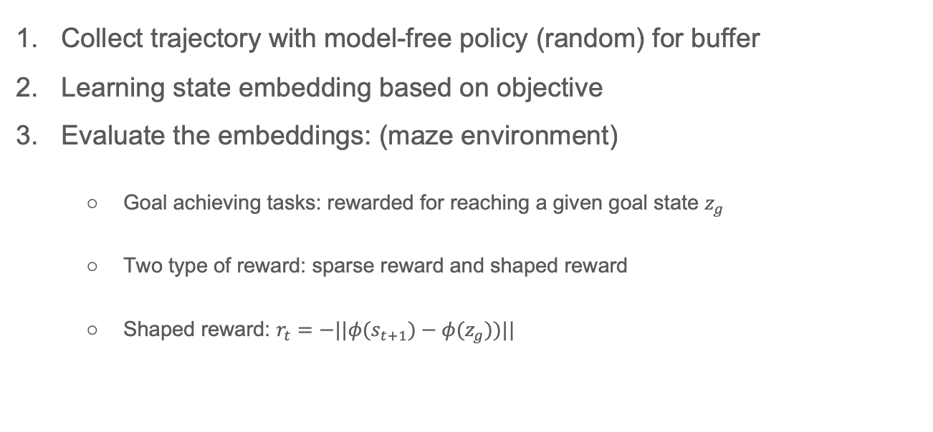
Experiment
Collect trajectory with model-free policy (random) for buffer
Learning state embedding based on objective
Evaluate the embeddings: (maze environment)
Goal achieving tasks: rewarded for reaching a given goal state $z_{g}$
Two type of reward: sparse reward and shaped reward
Shaped reward: $r_{t}=−||φ(s_{t+1})−φ(z_{g}))||$
Notes:
Different policy different transitional probability
Goal achieving task or goal reaching task, which is popular in recent year RL paper.
Other than sparse reward which is often used in goal reaching RL, they use shaped reward
This reward will provide more supervision than sparse one, when the distance can be reflected as real distance in phi

Slide 33
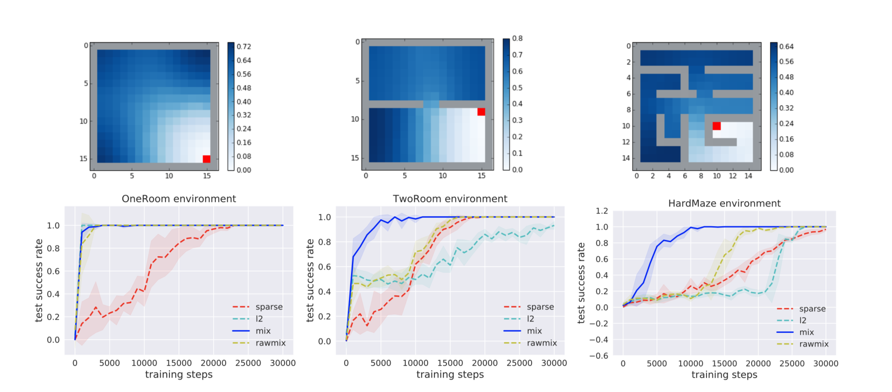
Experiment
RL algorithm: DQN¹
1. Mnih, Volodymyr, et al. "Human-level control through deep reinforcement learning." Nature 518.7540 (2015): 529.
Notes:
X is training steps, y is the success rate of reaching the goal
L2 is the distance of raw state space, not the learned one
In one room, no wall, so all the reward is the same

Slide 34
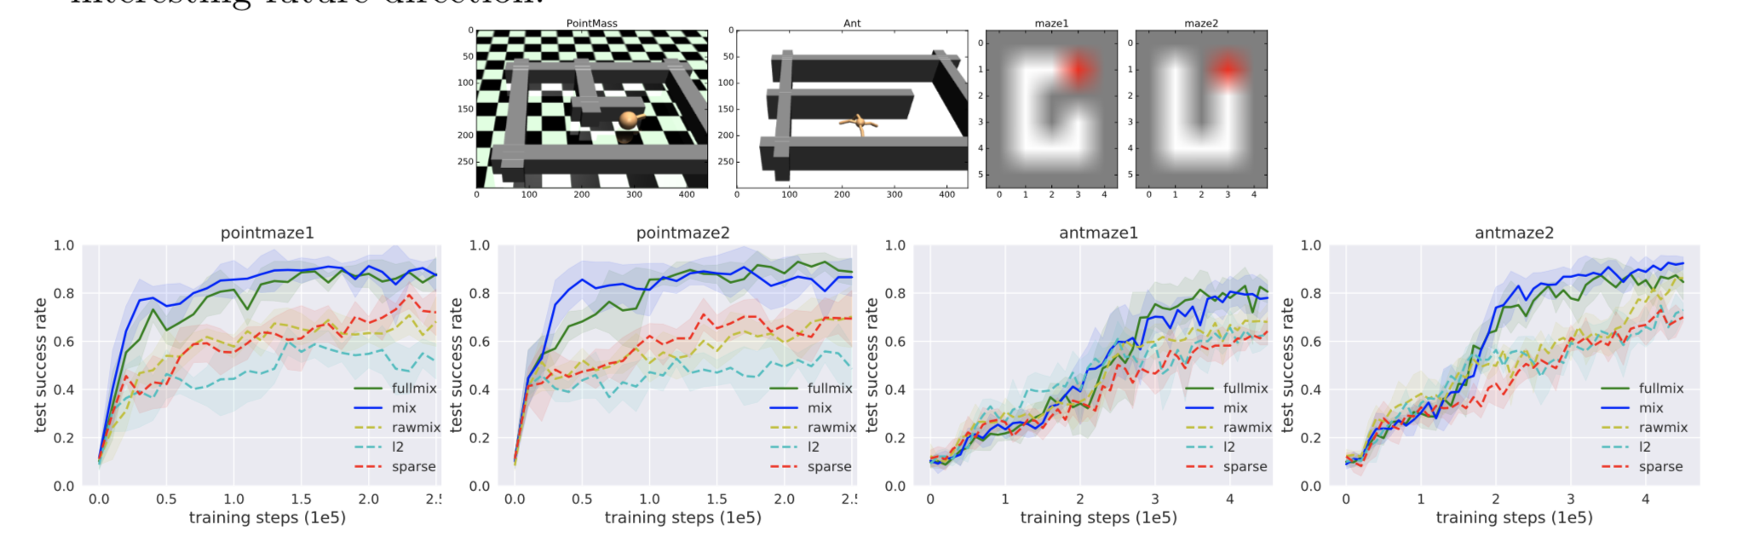
Experiment on continues state
RL algorithm: DDPG¹
1. Lillicrap, Timothy P., et al. "Continuous control with deep reinforcement learning." arXiv preprint arXiv:1509.02971 (2015).
Notes:
Mix and full mix! In this case physical agent, so it needs more state space other the coordinate x,y

Slide 35
Summary
Laplacian: both map and operator
Laplacian induced representation can encode local structure
Eigenfunction/eigenvalue of L can be good basis

Slide 36
Thank you and happy valentine day !

